Slide 1

stratustime gives you time
cloud-based time & attendance
© 2018 nettime® solutions www.nettimesolutions.com
Notes:
Sales reps may remove slides as they feel appropriate.

Slide 2
This is your time
Your team
Your time & attendance needs
nettime solutions cloud-based time & attendance
nettime solutions product demonstration
Your nettime solutions support team
Your questions

Slide 3
Your team
Notes:
This is an opportunity for the sales rep to make introductions and be sure they understand the client’s team.

Slide 4
Your time & attendance needs
Notes:
This is an opportunity to review what the sales rep knows about a client’s time & attendance needs, and to gather more information.

Slide 5
2018 Time & Attendance Trends
Low Unemployment
Self-service
Remote workers
Employee burnout
Increase in time theft concerns
Notes:
Low unemployment
low unemployment creates an environment where employees have more options with who they work for, potentially driving high rates of turnover
Self-service
self-service matters: both employees and managers expect systems that allow employees to check schedules, plan time off, see PTO accruals, and even swap shifts without having to bother management
Remote workers
According to a Gallup survey, 43% of Americans report working remotely for at least some of the work week (up from 39%), while 31% report working remotely for most of the work week (up from 31%) The ability to work remotely is becoming an increasingly important employee perk.
Employee burnout
Service and health care workers are increasingly suffering burnout from overtime and double shifts
Increase in time theft concerns
With the increase in remote workers and remote management, come additional concerns about time theft. And if one employee in a location begins cheating on hours, there can often be a cascade effect that costs money and negatively impacts morale

Slide 6
nettime solutions cloud-based time & attendance
For employees
stratustime is a friendly, intuitive way for employees to clock in, out, request time off, view schedules, see PTO and sick day accruals, and more, from any device.

Slide 7
nettime solutions cloud-based time & attendance
For employees
stratustime saves managers time with an easy scheduling interface and an alert system to notify them when employees are late, absent, or want to swap shifts*.
*shift swapping available with Advanced Scheduling module.
For management

Slide 8
nettime solutions cloud-based time & attendance
For employees
It also provides geotracking and geofencing capabilities, allowing managers to see where employees are clocking in, and preventing them from clocking in when away from approved locations.
For management

Slide 9
nettime solutions cloud-based time & attendance
For employees
stratustime is a robust labor reporting mechanism that can both help them stay compliant and provide deep insight into labor costs.
For management
For owners & executives

Slide 10


“I love stratustime because it’s very simple to set up and use. We have employees from across the spectrum—white collar, blue collar, warehouse, sales, management, you name it. Everyone agrees on how easy it is.”
© 2018 nettime® solutions www.nettimesolutions.com

Slide 11
Why stratustime?
Easy-to-use
Employee self-service that requires little to no training
Accurate timesheets can help you comply with wage and hour requirements
Easy labor reporting to assist with lowering labor costs

Slide 12

“stratustime gives you the flexibility to customize any available report. If we’d had stratustime during the entirety of the employee’s career, it would have been pretty simple to pull the data and generate a report. But we didn’t, and my own time was burnt up capturing and presenting this information.”
© 2018 nettime® solutions www.nettimesolutions.com
Notes:
Quote from stratustime customer, Tara Hood

Slide 13
Why stratustime?
Easy-to-use
Customizable to accommodate a variety of company rules
Grows as the company grows
Advanced scheduling for enterprise business
Flexible

Slide 14
Why stratustime?
Easy-to-use
Accessible through multiple devices
Automatic transmission to payroll
Easy integration with most accounting systems
Flexible
Plays nice

Slide 15

“It’s essential that the system you have in place ensures that everyone is tracking their time correctly, whether it’s overtime, or breaks, or something else. It can save you a lot of money, hassle, and potential legal exposure.”
© 2018 nettime® solutions www.nettimesolutions.com
Notes:
Quote from stratustime customer, Paula Schubel

Slide 16
Why stratustime?
Easy-to-use
Backed by Paychex
60+ team of compliance professionals tracking applicable laws and regulations, including employment laws
Redundant servers and hot backups to help prevent downtime
Flexible
Plays nice
Reliable

Slide 17
Why stratustime?
Easy-to-use
Your own dedicated stratustime sales representative and support
Flexible
Plays nice
Reliable
Supportive

Slide 18
Advanced Module Add-Ons
Customized Labor Force Analytics
ACA Tracking
Advanced Scheduling with Shift Swapping
Budgeting
Alerts
Compensatory Time
Time Forecasting
Points Tracking
Accruals
Offline Punching

Slide 19
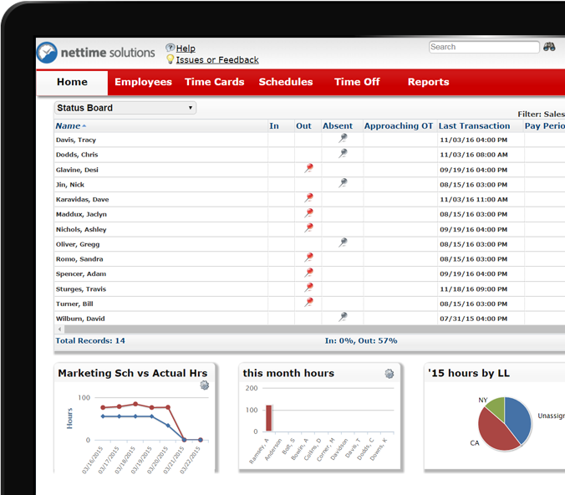
Our open API
stratustime uses an open API
Offers multiple methods for interacting with data: XML, JSON or SOAP
Allows for manipulation of employee data, add punches, export time and much more
Can be customized to present seamlessly
File integration ability

Slide 20





Clients
Notes:
NetSuite Integration

Slide 21
Demo

Slide 22
Q & A

Slide 23

Your Name Here
Your email Here | Your Phone Here
www.nettimesolutions.com
© 2018 nettime® solutions www.nettimesolutions.com

